Slide 1

Programming Project: Syntax analyzer

Slide 2

Goal
Use the BNF grammar we discussed in the video link below.
Implement a syntax analyzer that checks grammar against a source code base.
The source code will be read from left to right to check if there are syntax errors
Integrate the lexical analyzer you created previously.

Slide 3
Grammar Rules
var_dec ::= data_type dec ;
data_type ::= boolean
::= float
::= int
::= String
::= byte
::= long
::= short
dec::= identifier [=exp]
::= identifier, dec
Exp:= exp (+|*|/|-) exp
::= ( exp )
::= a-z-A-Z [exp]
::= 0 - 9 [exp]
identifier:(a-z-A-Z) [a-z-A-Z-0-9_]

Slide 4
List of possible errors covered in the code
Syntax error, insert ";" to complete LocalVariableDeclarationStatement
> int a
Syntax error on token \""+ tokens[idx]+"\", invalid AssignmentOperator
Syntax error on token ")", expected Identifier or Constant or "(“
int a=);
Syntax error on token \""+ sub_tokens[0]+"\", expected Identifier or Constant
Error: " + tokens[idx + 1] + " is not an identifier"
Error: " + tokens[idx] + " is not a constant"
Error: " + tmp + " is not a data type
aint; aint+aint
aint+aint;
Error: " + sub_tokens[0] + " expected \"Identifier\"
int=;

Slide 5
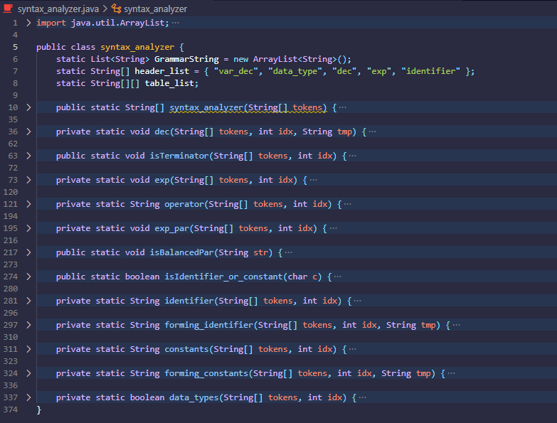
Main
Function that return s the parse tree of the given syntax code
The summary of Function use in checking the grammar if it is a valid syntax code or not.
Function that covers the choices in dec where if the tokens[2] is = or , or none
Function that checks if the last index is terminator
Function that path where choice from dec is =
Function that checks the conditions being fulfilled from <exp> <op> <exp>
Function that check if users has ( brace then copy the token from the index of ( until end
Function that check the if the token has balanced parenthesis then identify for errors
Function that return Boolean to isBalanced if certain index is identifier or constant for checking
Function that throws error if it is not identifier and return the string of successive identifier
Function that return the string of successive identifier
Function that return s the parse tree of the given syntax code
Function that throws error if it is not constant and return the string of successive identifier
Function that return if it is a data_type

Slide 6
Header rule Flowchart {Data_type, DEC, exp, IDENTIFIER

Slide 7
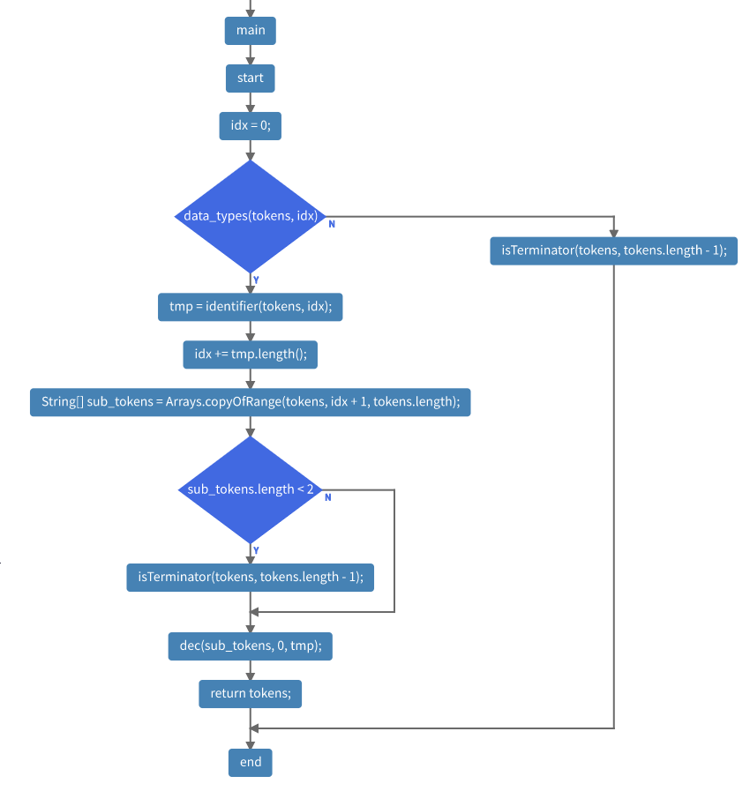
Syntax analyzer

Slide 8
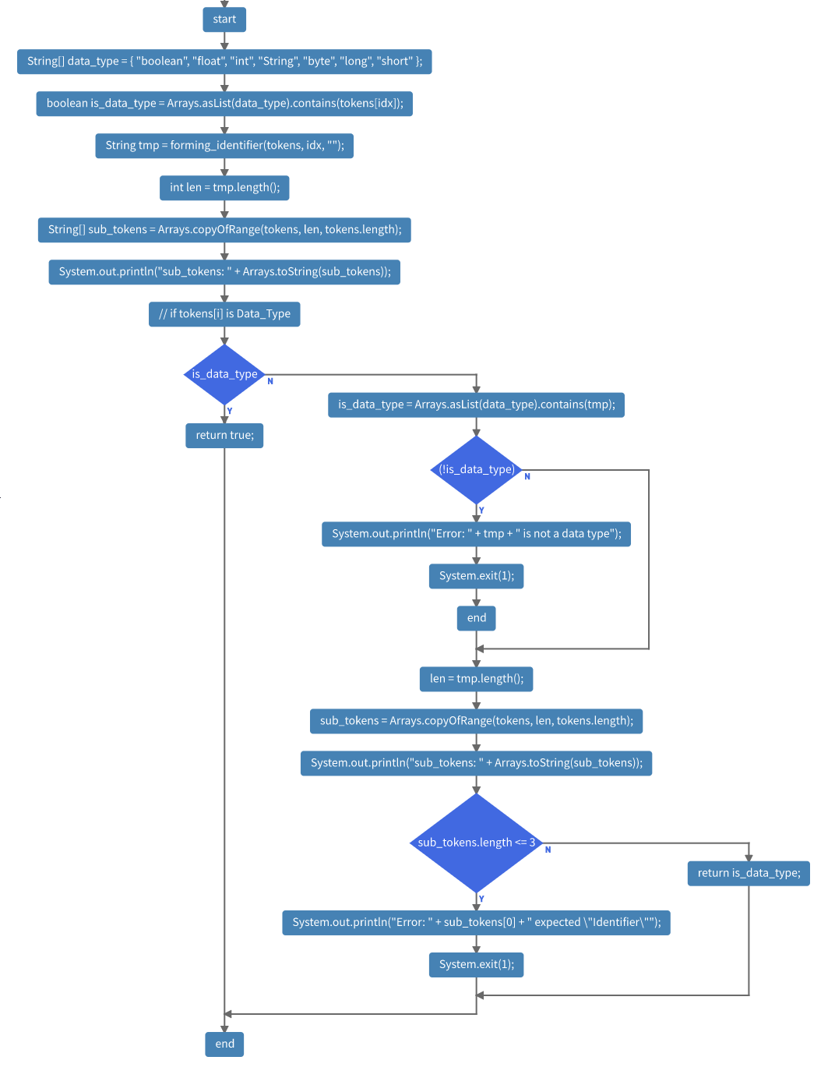
Data_type

Slide 9
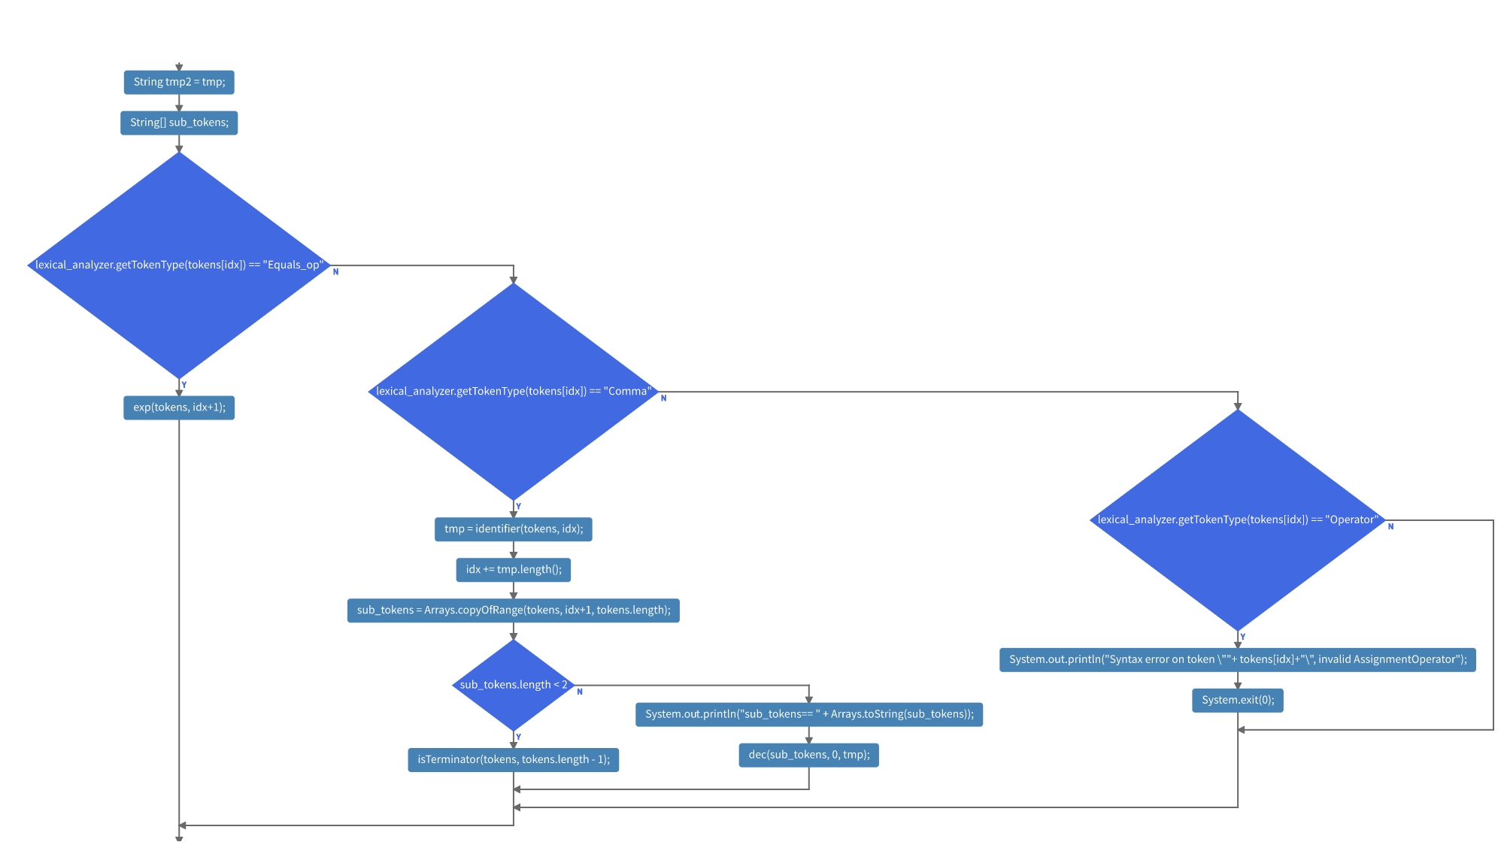
Declaration

Slide 10
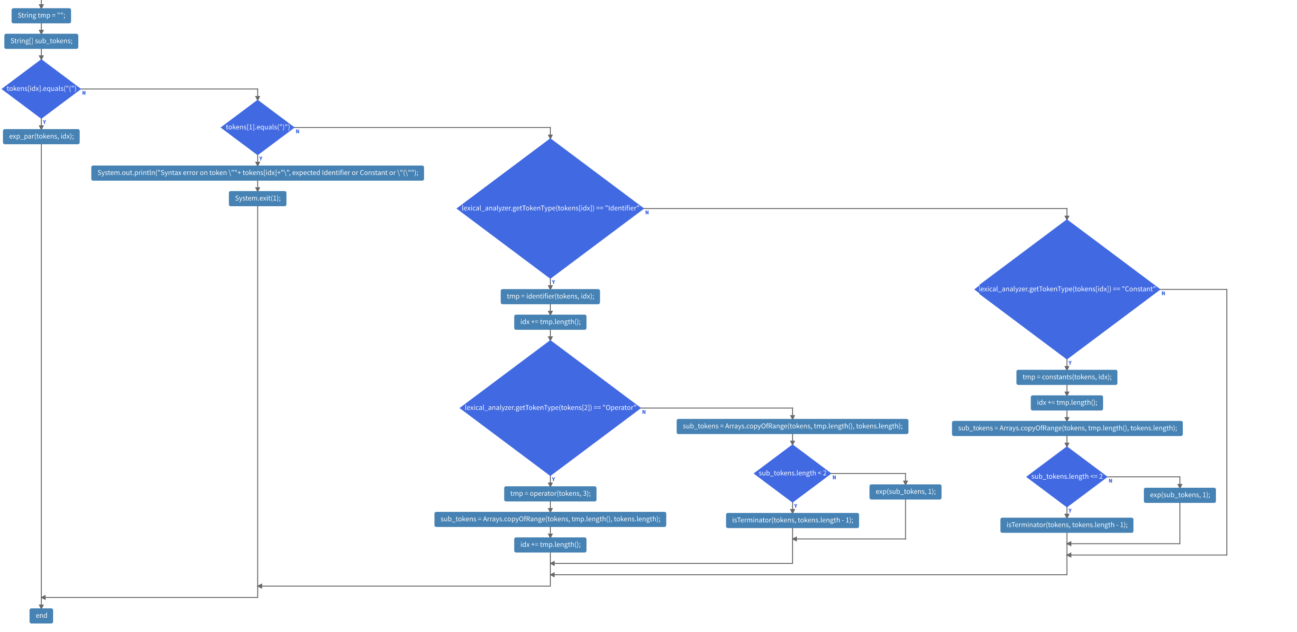
EXPression

Slide 11
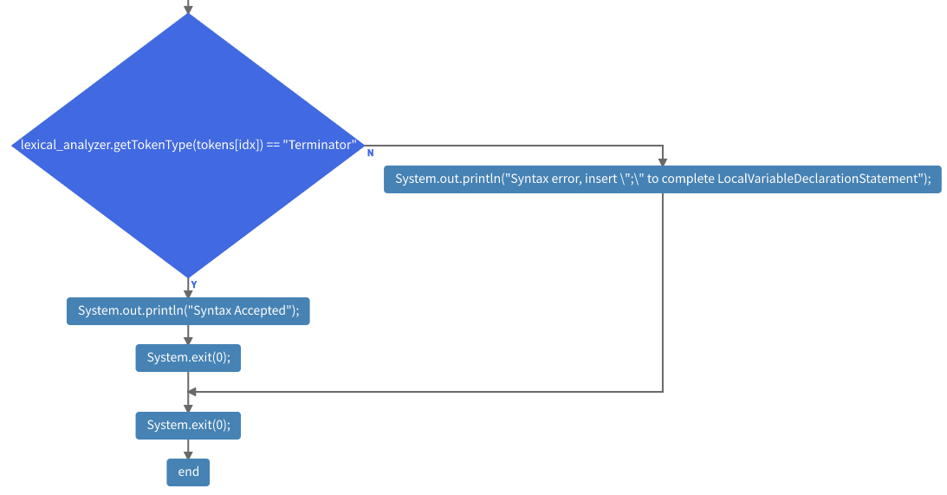
Terminator

Slide 12
Sub - function flowchart

Slide 13
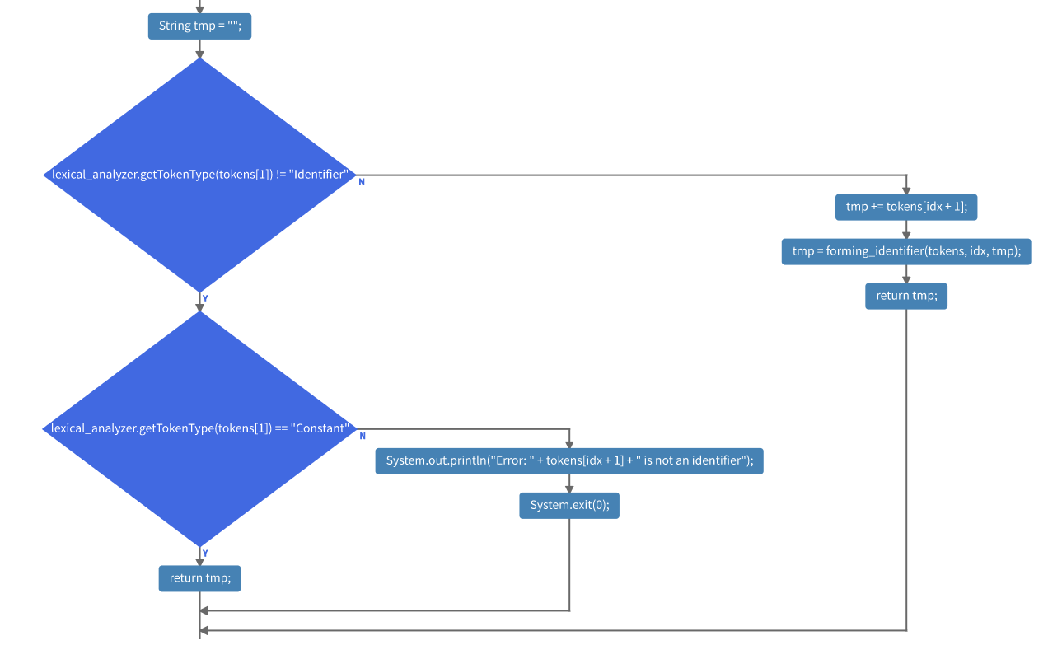
IIdentifier

Slide 14
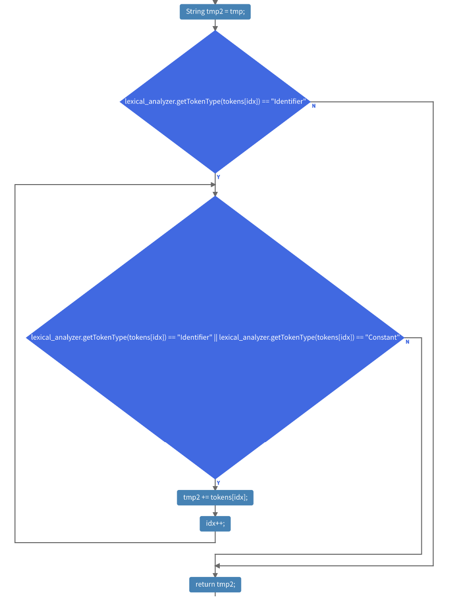
forming identifier

Slide 15
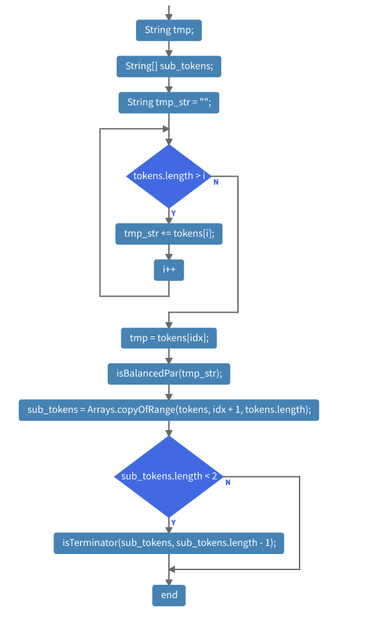
constants

Slide 16
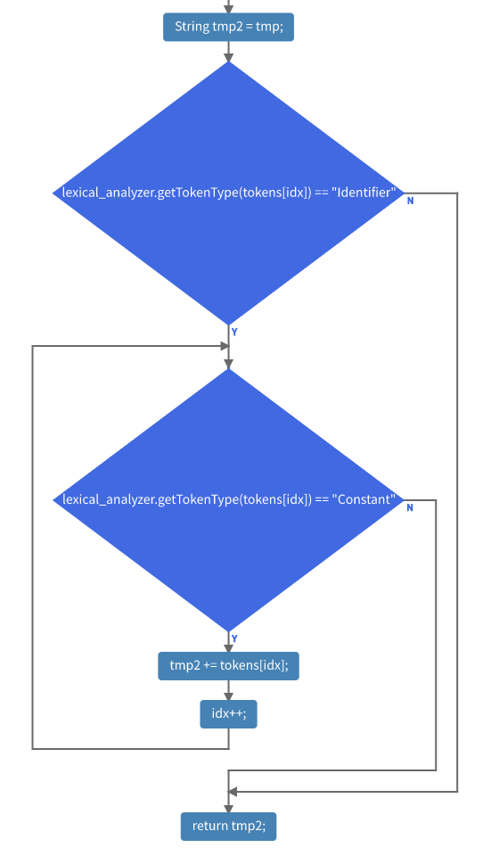
forming constant

Slide 17
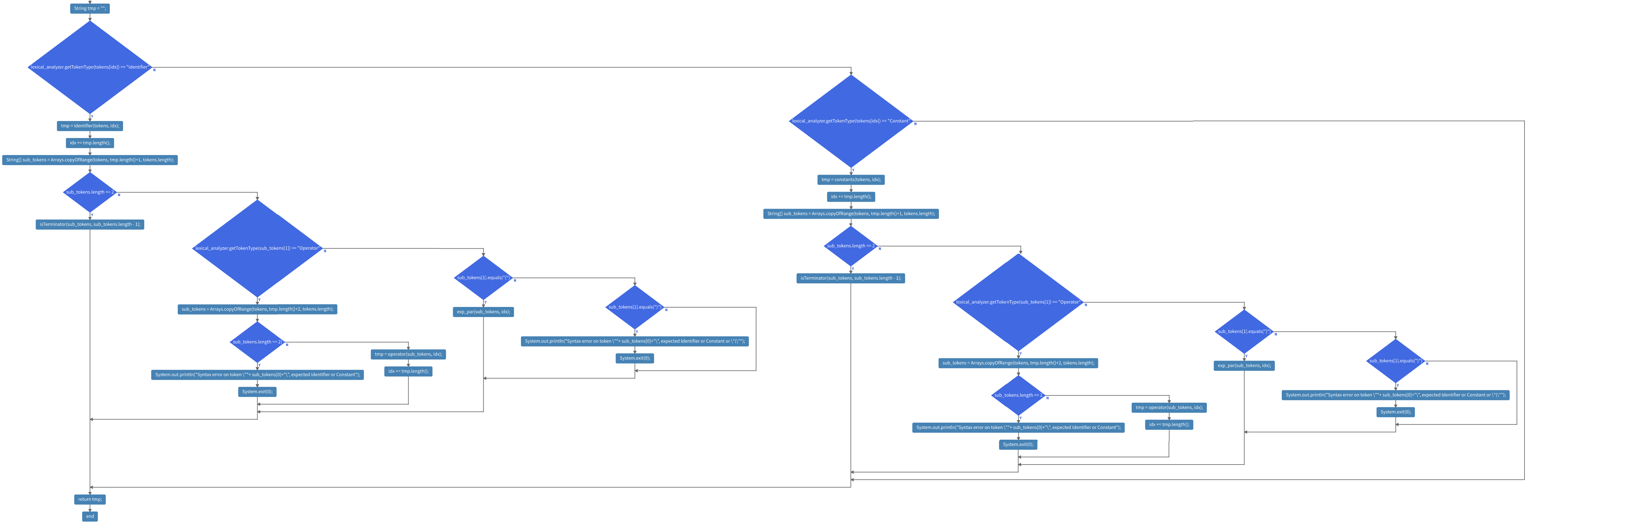
OPerator

Slide 18
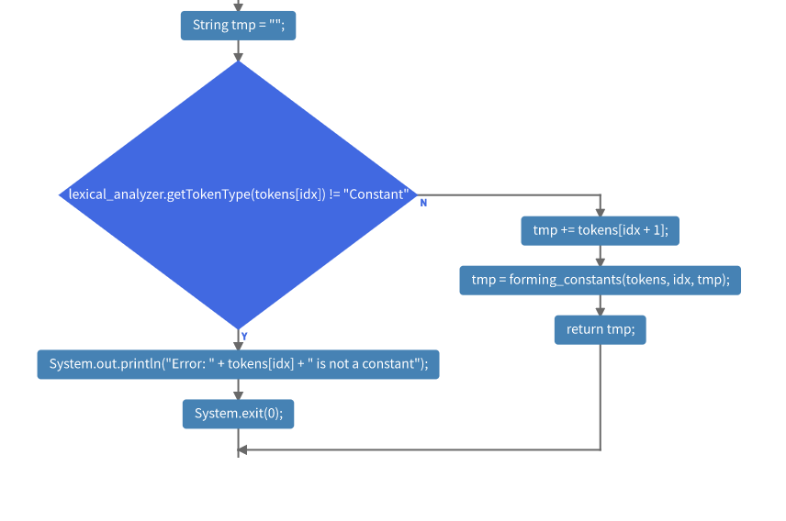
Exp Parenthesis

Slide 19
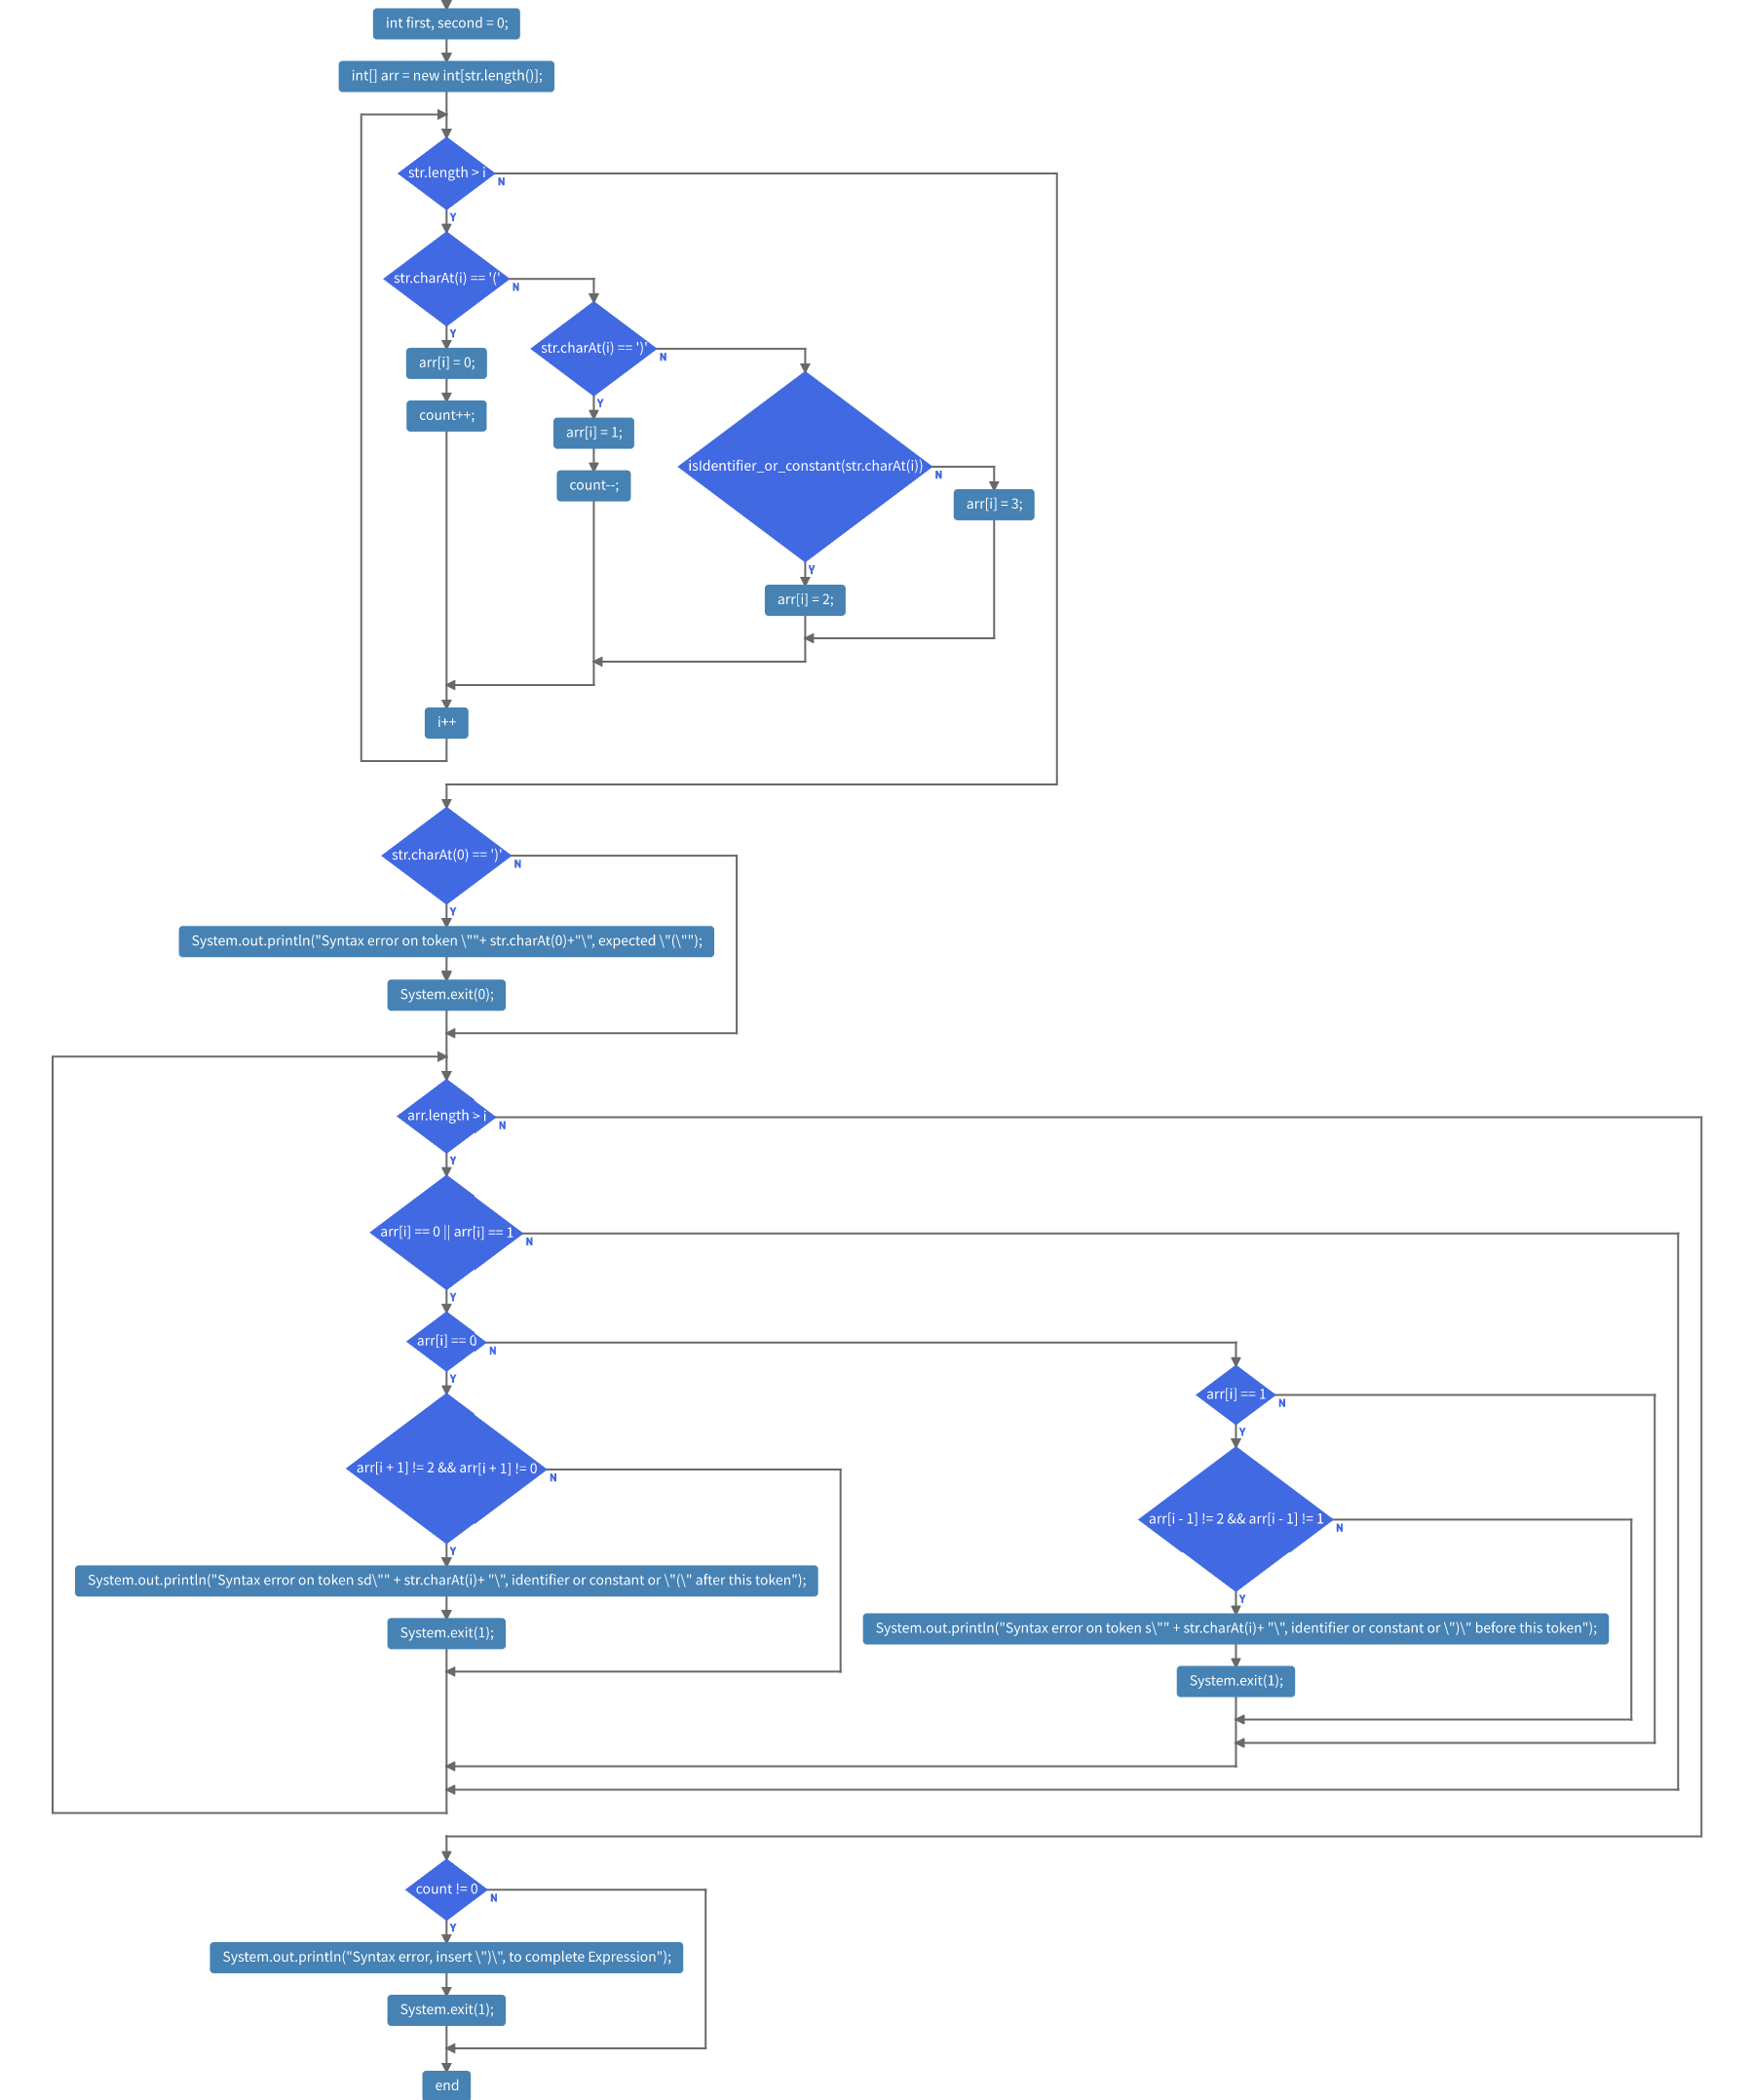
isbalanced

Slide 20
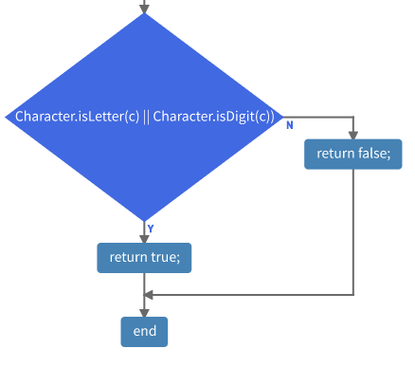
ischar

Slide 21
Links
Link of the Code:
https://github.com/cristoph143/Programming-Languages.git

Slide 22
Thank you for listening Hope to pass this semester!

